Slide 2

Chapter 3: Networked Communications

Slide 3
Chapter Overview
Introduction
Spam
Internet interactions
Text messaging
Censorship
Freedom of expression
Children and inappropriate content
Breaking trust
Internet addiction

Slide 4
Introduction
Networked communications integral to our lives
Internet
Cellular networks
Variety of uses
Communicating
Information gathering
Shopping
Game-playing
Etc.

Slide 5
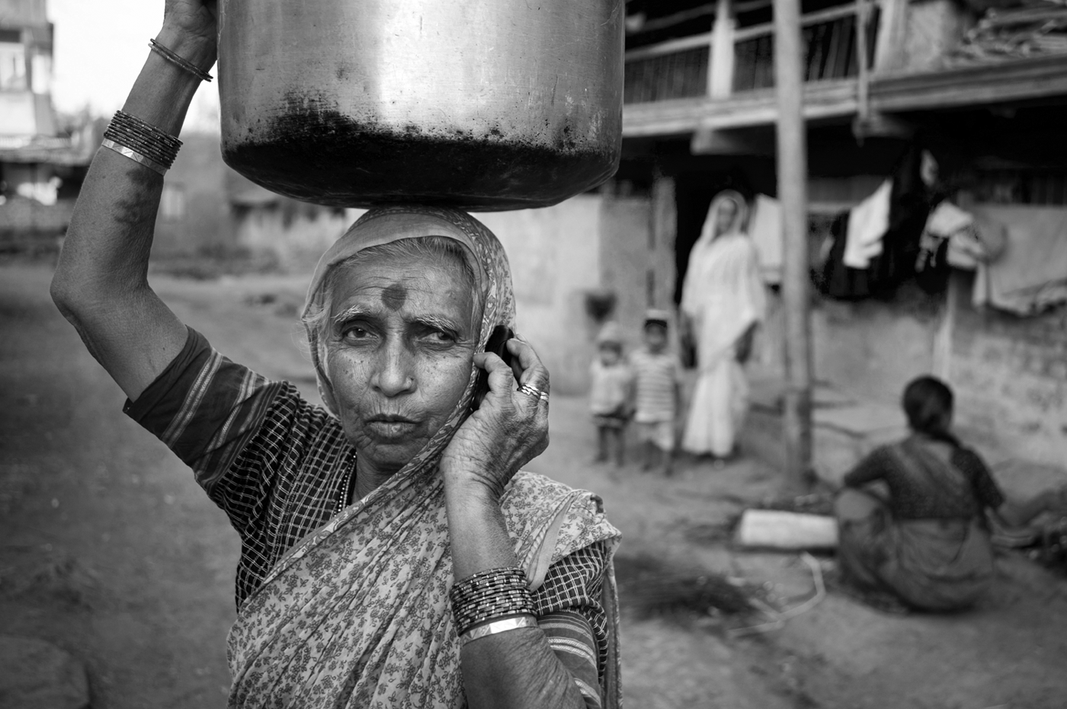
Far More People Have Access to Cell Phones than Electricity or Clean Water
Charles Sturge/Alamy

Slide 6
3.2 Spam

Slide 7
The Spam Epidemic (1/3)
Spam: Unsolicited, bulk email
Spam is profitable
$10 to send an ad to a million email addresses
More than 30,000 times cheaper than “junk mail”
Amount of email that is spam has ballooned
8% in 2001
90% in 2009

Slide 8
The Spam Epidemic (2/3)

Slide 9
The Spam Epidemic (3/3)
How firms get email addresses
Web sites, chat-room conversations, newsgroups
Computer viruses harvest addresses from PC address books
Dictionary attacks
Contests
Most spam sent out by bot herders who control huge networks of computers
Spam filters block most spam before it reaches users’ inboxes

Slide 10
Need for Socio-Technical Solutions
New technologies sometimes cause new social situations to emerge
Calculators → feminization of bookkeeping
Telephones → blurred work/home boundaries
Spam an example of this phenomenon
Email messages practically free
Profits increase with number of messages sent
Strong motivation to send more messages
Internet design allows unfair, one-way communications

Slide 11
Case Study: Ann the Acme Accountant
Ann: Accountant at Acme Corporation
She distributes paychecks to all 50 employees
Ann sends email advertising Girl Scout cookie sale
9 recipients order cookies; average 4 boxes each
Other 40 recipients unhappy to get email; half complain to a co-worker
Did Ann do anything wrong?

Slide 12
Kantian Analysis
We should always respect autonomy of others, treating them as ends in themselves and never only as the means to an end (2nd formulation of Categorical Imperative)
Ann didn’t misrepresent what she was doing
She didn’t force anyone to read the entire email
Some who read her email chose to order cookies
Therefore, she didn’t “use” others, and her action was not strictly wrong
However, an “opt in” approach would have been better

Slide 13
Act Utilitarian Analysis
Benefit to Girls Scouts = $108
$3 profit per box of cookies
36 boxes sold
Harm to company: time wasted
Orders taken during breaks
Lost productivity from complaining: $70
20 employees ×2 ×5 minutes/employee = 200 minutes
3.5 hours ×$20/hour = $70
Benefits exceed harms, so action good
Company may create policy against future fundraisers

Slide 14
Rule Utilitarian Analysis
Q: What would be consequences of everyone in company used email to solicit donations?
A: Plenty of employee grumbling and lower morale
If all doing it, unlikely any one cause would do well
Harms greater than benefits, so Ann’s action was wrong

Slide 15
Social Contract Theory Analysis
Acme Corporation has no prohibition against using its email system this way
Ann was exercising her right to express herself
Some people didn’t appreciate message, but she didn’t act like a spammer
She didn’t conceal her identity
She wasn’t selling a fraudulent product
Ann did nothing wrong

Slide 16
Virtue Ethics Analysis
As employee, relevant virtues: honesty, fairness, respect
Ann was honest: her email didn’t mislead anyone
However, she wasn’t fair or respectful, and she exercised poor judgment (as evidenced by larger amount of complaining by co-workers)
In her role as parent, she did all work herself and didn’t find a role for her daughter to play
Ann should have found a way for her daughter to help, and she should have found another way to advertise that respected her co-workers

Slide 17
Summary
Analyses reached different conclusions, but Ann could have taken a less controversial course
She could have posted a sign-up sheet to identify those interested in cookie sale
That way, she would have sent email only to those interested, avoiding the problems of grumbling and lost productivity
She could have found a way to get her daughter more engaged

Slide 18
3.3 Internet Interactions

Slide 19
The World Wide Web
WWW : networked hypertext system
Stimulated tremendous growth in popularity of Internet
Two important attributes
It is decentralized
Every Web object has a unique address

Slide 20
3.4 Text Messaging

Slide 21
Transforming Lives in Developing Countries
M-PESA in Kenya
Save money
Pay bills
Transfer funds
Communicate information about crop prices
Protect against counterfeit medicine

Slide 22
Twitter
Web-based social networking service
More than 200 million users
Blogging tool
Business promotion
Role in Arab Spring uprisings debated
(+) Social networks lead to politicization
(-) Ties in social networks too weak for high-risk activism

Slide 23
3.5 Censorship

Slide 24
Forms of Direct Censorship
Government monopolization
Prepublication review
Licensing and registration

Slide 25
Self-censorship
Most common form of censorship
Group decides for itself not to publish
Reasons
Avoid subsequent persecution
Maintain good relations with government officials (sources of information)
Ratings systems created to advise potential audience
Movies, TVs, CDs, video games
Not the Web

Slide 26
Challenges Posed by the Internet
Many-to-many communications
Dynamic connections
Huge numbers of Web sites
Extends beyond national borders, laws
Hard to distinguish between minors and adults

Slide 27
Governmental Filtering and Surveillance
North Korea: Internet virtually inaccessible
Saudi Arabia: centralized control center
China
Blocks Internet access at times of social unrest
Has “one of most sophisticated filtering systems in the world”
Germany: Forbids access to neo-Nazi sites
United States: Repeated efforts to limit access of minors to pornography

Slide 28
Ethical Perspectives on Censorship
Kant opposed censorship
Enlightenment thinker
“Have courage to use your own reason”
Mill opposed censorship
No one is infallible
Any opinion may contain a kernel of truth
Truth revealed in class of ideas
Ideas resulting from discourse are more influential

Slide 29
Mill’s Principle of Harm
“The only ground on which intervention
is justified is to prevent harm to others;
the individual’s own good is not a
sufficient condition.”

Slide 30
3.5 Censorship

Slide 31
Forms of Direct Censorship
Government monopolization
Prepublication review
Licensing and registration

Slide 32
Self-censorship
Most common form of censorship
Group decides for itself not to publish
Reasons
Avoid subsequent persecution
Maintain good relations with government officials (sources of information)
Ratings systems created to advise potential audience
Movies, TVs, CDs, video games
Not the Web

Slide 33
Challenges Posed by the Internet
Many-to-many communications
Dynamic connections
Huge numbers of Web sites
Extends beyond national borders, laws
Hard to distinguish between minors and adults

Slide 34
Governmental Filtering and Surveillance
North Korea: Internet virtually inaccessible
Saudi Arabia: centralized control center
China
Blocks Internet access at times of social unrest
Has “one of most sophisticated filtering systems in the world”
Germany: Forbids access to neo-Nazi sites
United States: Repeated efforts to limit access of minors to pornography

Slide 35
Ethical Perspectives on Censorship
Kant opposed censorship
Enlightenment thinker
“Have courage to use your own reason”
Mill opposed censorship
No one is infallible
Any opinion may contain a kernel of truth
Truth revealed in class of ideas
Ideas resulting from discourse are more influential

Slide 36
Mill’s Principle of Harm
“The only ground on which intervention
is justified is to prevent harm to others;
the individual’s own good is not a
sufficient condition.”

Slide 37
3.6 Freedom of Expression

Slide 38
Freedom of Expression: History
De Scandalis Magnatum (England, 1275)
Court of Star Chamber
18th century
No prior restraints on publication
People could be punished for sedition or libel
American states adopted bills of rights including freedom of expression
Freedom of expression in 1st amendment to U.S. Constitution

Slide 39
1st Amendment to U.S. Constitution
Congress shall make no law respecting an
establishment of religion, or prohibiting the
free exercise thereof (1); or abridging the
freedom of speech, or of the press (2); or the
right of the people peaceably to assemble (3),
and to petition the government for a
redress of grievances (4).

Slide 40
Freedom of Expression Not an Absolute Right
1st Amendment covers political and nonpolitical speech
Right to freedom of expression must be balanced against the public good
Various restrictions on freedom of expression exist

Slide 41
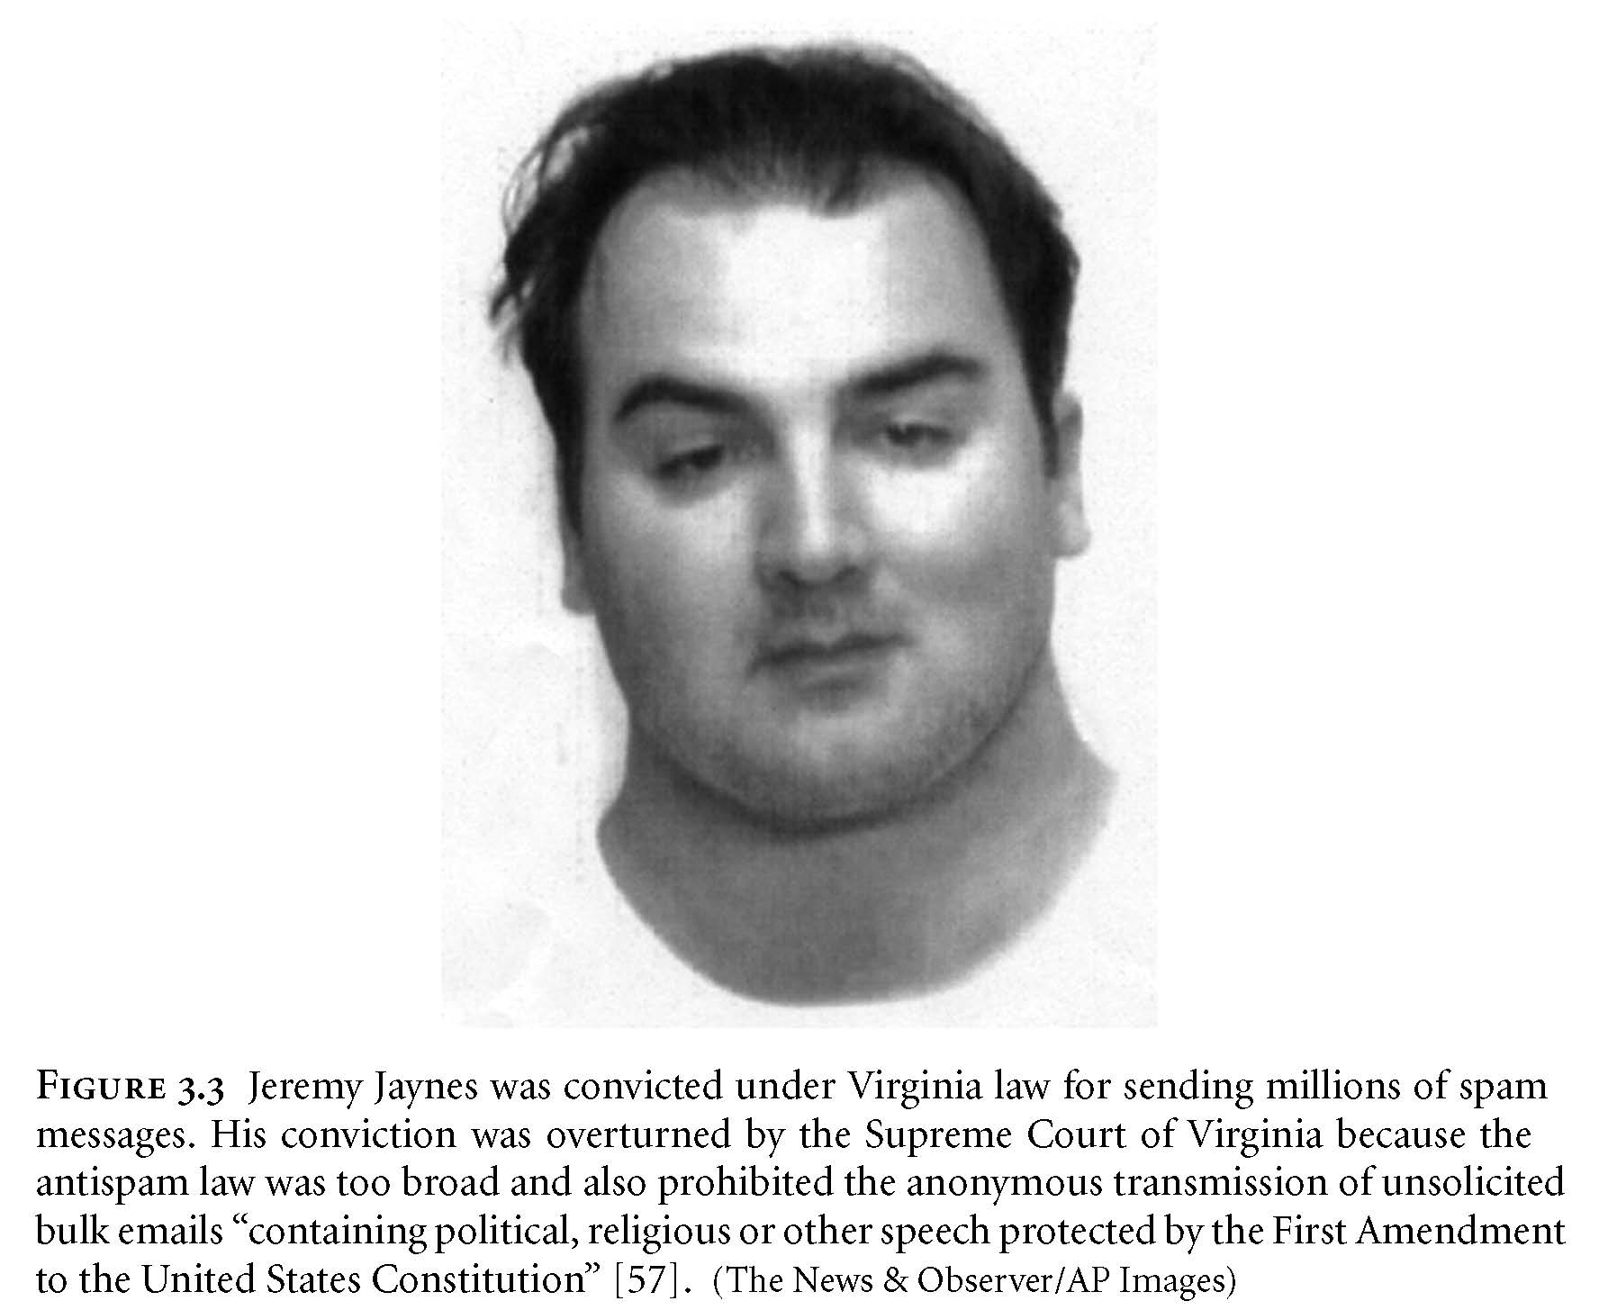
Jeremy Jaynes
<Insert image from Figure 3.3 here>
AP Photo/Loudoun County Sheriff’s office

Slide 42
FCC v. Pacifica Foundation et al.
George Carlin records “Filthy Words”
XS Contains language some may find offensive – 7 Words you can’t say on TV
WBAI in New York airs “Filthy Words” (1973)
FCC issues declaratory order to Pacifica
Pacifica sues
U.S. Supreme Court ruled FCC did not violate 1st Amendment (5-4 decision)
Broadcast media “uniquely pervasive”
Broadcasting uniquely accessible to children

Slide 43
3.7 Children and Inappropriate Content

Slide 44
Web Filters
Web filter: Software that prevents display of certain Web pages
May be installed on an individual PC
ISP may provide service for customers
Methodologies
Maintain “black list” of objectionable sites
Examine content for objectionable words/phrases

Slide 45
Child Internet Protection Act
Libraries receiving federal networking funds must filter pages containing obscenity or child pornography
U.S. Supreme Court ruled CIPA did not violate 1st Amendment guarantees (6-3 decision in June 2003)

Slide 46
Ethical Evaluations of CIPA
Kantian evaluation: CIPA is wrong
Act utilitarian evaluation: depends on how benefits and harms are weighed
Social contract theory: freedom of conscience should be given precedence

Slide 47
Sexting
Definition: sexually suggestive text messages or emails with nude or nearly nude photographs
In a 2009 survey, 9% of U.S. teenagers admitted to sending a sext, 17% admitted to receiving a sext
Case of Jesse Logan
Case of Ting-Yi Oei
Case of Phillip Alpert

Slide 48
3.8 Breaking Trust

Slide 49
Identity Theft (1/2)
Identity theft: When a person uses another person’s electronic identity
Leading form of identity theft is credit card fraud
Financial institutions contribute to problem by making it easy to open new accounts
In 2012 about 7% of adults in U.S. reported being victims
50% of these victims reported losses exceeding $100
Consumer’s liability for credit card losses limited to $50

Slide 50
Identity Theft (2/2)
Nearly half of cases from lost credit card, checkbook, etc.
College students 5 times more likely to be victims
In 19% of cases, credit card number stolen at time of making purchase (skimmers)
About 1 million cases of identity theft annually in United States from online activities
Phishing: Use of email to attempt to deceive people into revealing personal information
Identity theft a federal crime, but only 1 in 700 cases results in an arrest

Slide 51
Online Predators
Instant messaging: software supporting real-time “chat” over the Internet
Kik Messenger, Whisper: popular apps
Child predators use apps to find victims
Police run sting operations
Sometimes result in dozens of arrests
Allegation: Extreme methods to maintain arrest rates

Slide 52
Ethical Evaluations of “Stings” (Thursday)
Utilitarian evaluation
Kantian evaluation
Social contract theory evaluation

Slide 53
False Information
Quality of Web-based information varies widely
Other media also have information of varying quality
The New York Times v. The National Enquirer
60 Minutes v. Conspiracy Theory
Google attempts to reward quality
Ranking uses “voting” algorithm
If many links point to a page, Google search engine ranks that page higher

Slide 54
Cyberbullying
Cyberbullying: Use of the Internet or phone system to inflict psychological harm
In a 2009 survey, 10% admitted to cyberbullying, and 19% said they had been cyberbullied
Case of Ghyslain Raza
Case of Megan Meier
Megan Meier Cyberbullying Prevention Act

Slide 55
Revenge Porn
Special case of cyberbullying
Posting pornographic image with malicious intent without consent of participant(s)
Case of Web site Is Anyone Up?
Criminalized in Germany, Israel, UK, and about half of U.S. states
Reddit, Twitter, Google have taken action to protect victims

Slide 56
3.9 Internet Addiction

Slide 57
Is Internet Addiction Real? (1/2)
Davidson: Electronic devices co-opt same brain systems indicated in addiction
Block: Three variants of Internet addiction
Excessive gaming
Sexual preoccupations
E-mail/text messaging
Block: Four characteristics of Internet addiction
Excessive use
Withdrawal
Tolerance
Negative repurcussions

Slide 58
Is Internet Addiction Real? (2/2)
American Psychiatric Association: insufficient data to list as a mental disorder
South Korea
Average high school student spends 23 hours/week gaming
Law prohibits children from gaming between midnight and 6 a.m.
China
Software discourages children from playing more than 3 hours/day

Slide 59
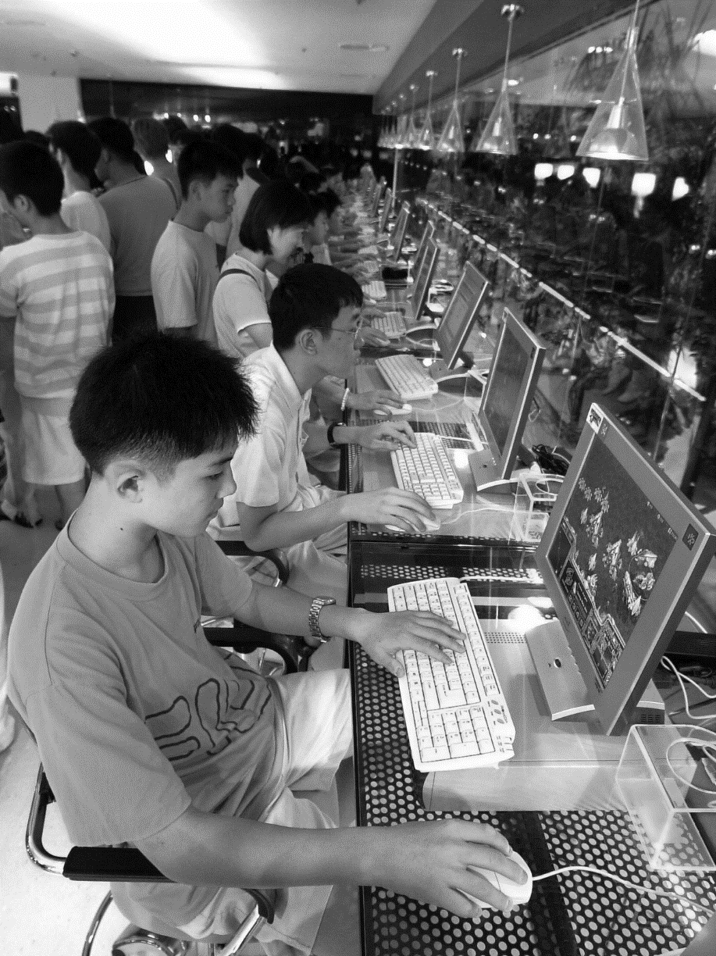
South Koreans in a PC Bang

Slide 60
Contributing Factors to Addiction
Social factors
Peer groups
Situational factors
Stress
Lack of social support and intimacy
Limited opportunities for productive activity
Individual factors
Tendency to pursue activities to excess
Lack of achievement
Fear of failure

Slide 61
Ethical Evaluation
Enlightenment view
Individuals can and should govern their lives
People are responsible for their choices
Jeffrey Reiman’s view
Addict’s behavior makes sense if addict has no hope for a better future
Society bears responsibility for putting people in hopeless situations

